Slide 1
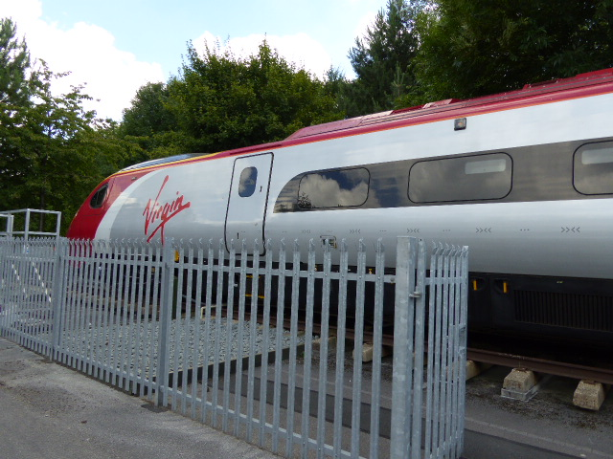
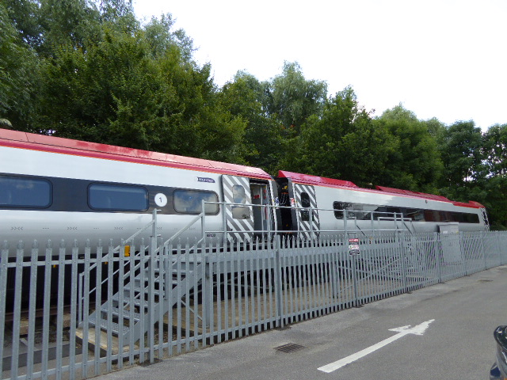

Virgin Demo Train
In Crewe, Virgin Rail have a 2-carriages Demo train which is a retired Pendolino train from 2007. The train is currently used for training and education purposes.
The Demo train consists of First Class, Dinning and 2nd Class seating and Train Control room and Kitchen compartments.
Their request is not to leaving any permanent damage, such as drilling holes and marking on the demo train.
PSNLE have done a rough preliminary measurement for the dimensions of the 2 demo-carriages.
Staff only Door
Kitchen
Train Control
Passenger Door
1st Class
Dinning
2nd Class
Passenger Door
Passenger Door

Slide 2
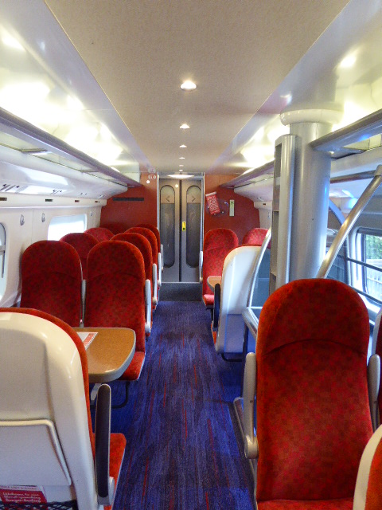
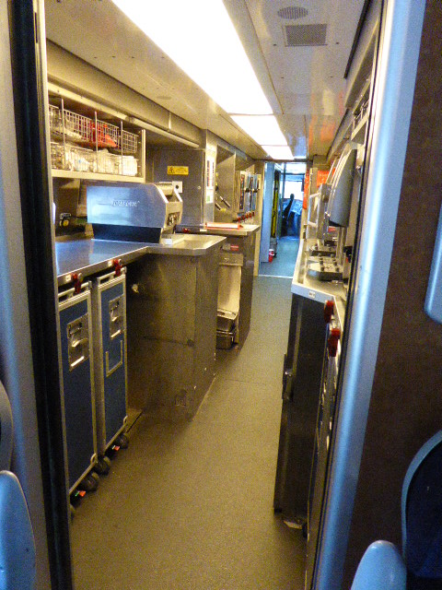
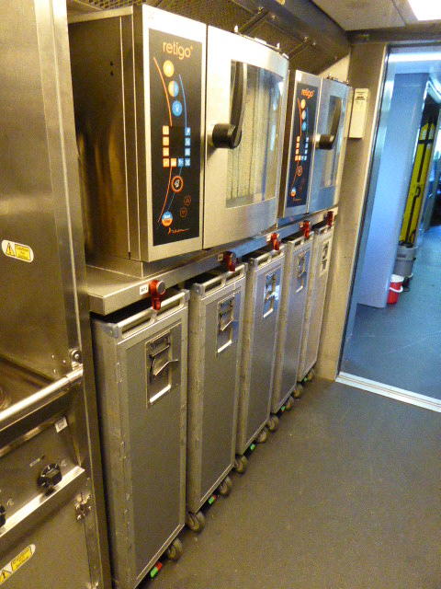
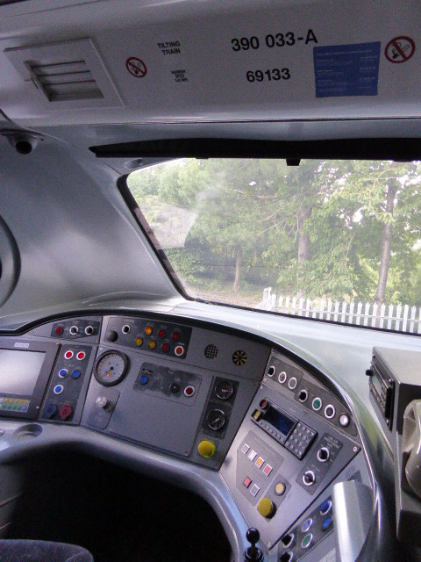
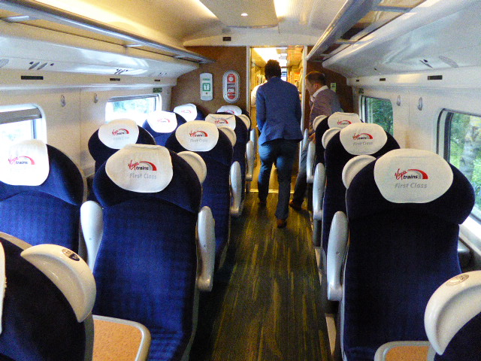
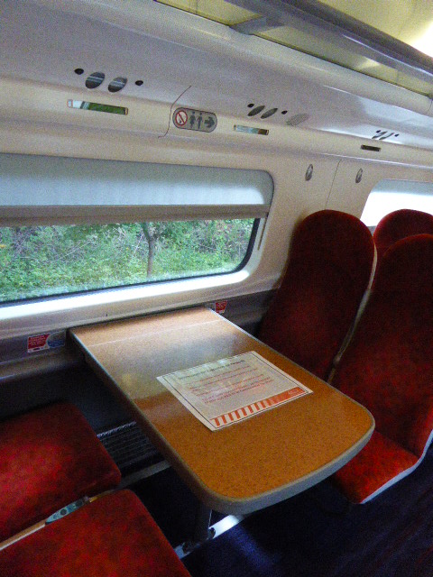
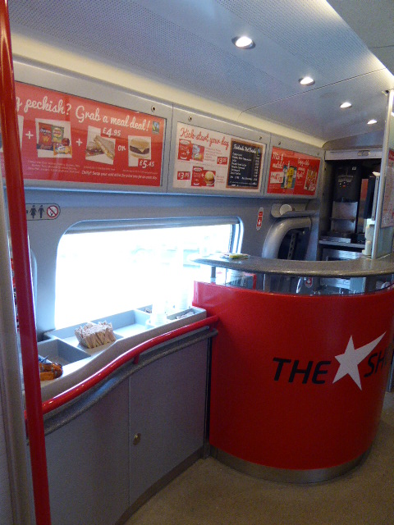
Demo-Train Interior
2nd Class
Kitchen
Train Control Room
1st Class
Dinning Carriage

Slide 3
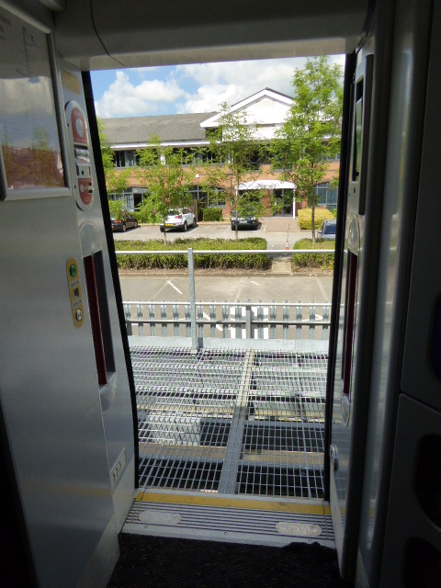
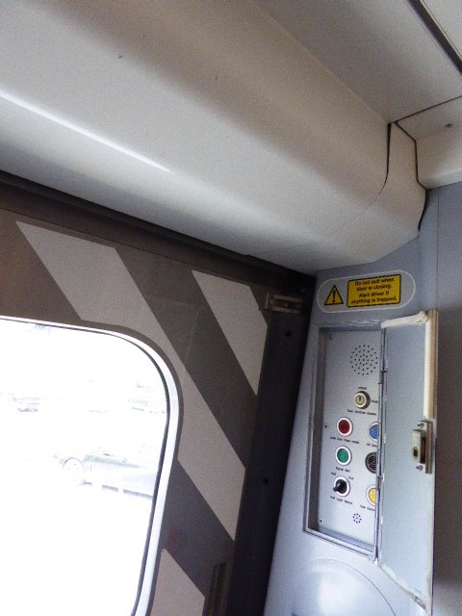
Dimensions : Train Entrance
81.5cm
90cm
11cm
17cm
181cm
27cm
Middle Door entrance
Top of Middle Door entrance

Slide 4
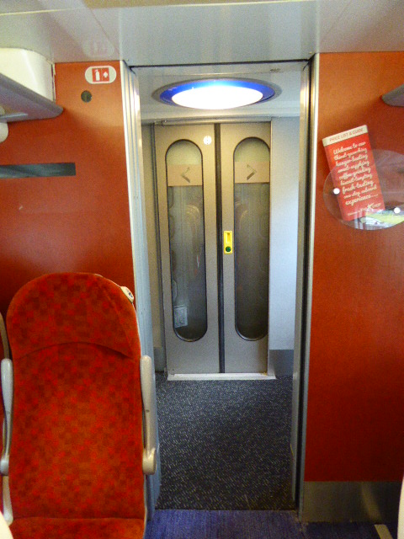
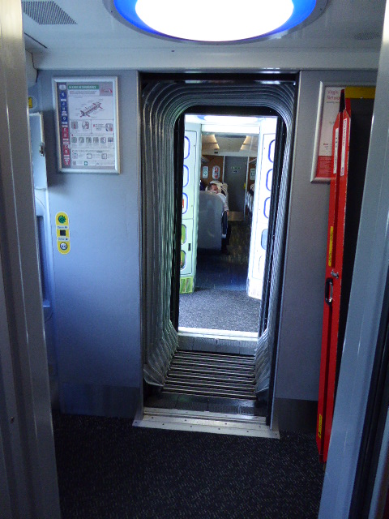
Dimensions : Carriage Entrance
65.5cm
75cm
189cm
190cm
196cm
Entrance into Passenger Carriage (2nd Class)
Entrances between Carriages

Slide 5
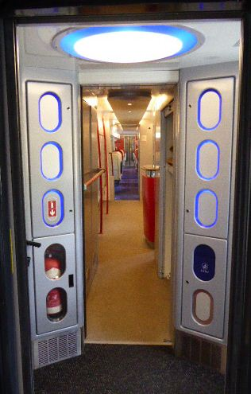
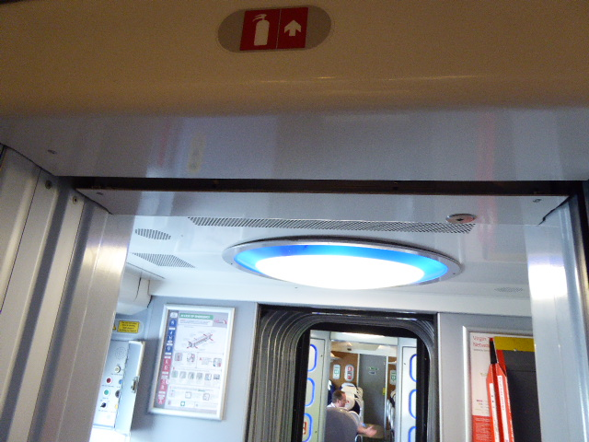
Dimensions : Entrance to Dining Carriage
65.5cm
14cm
32cm
16cm
4.5cm
190cm
12cm
Top of Entrance into Dining area
Entrance into Dining area (and 2nd Class Carriage)

Slide 6
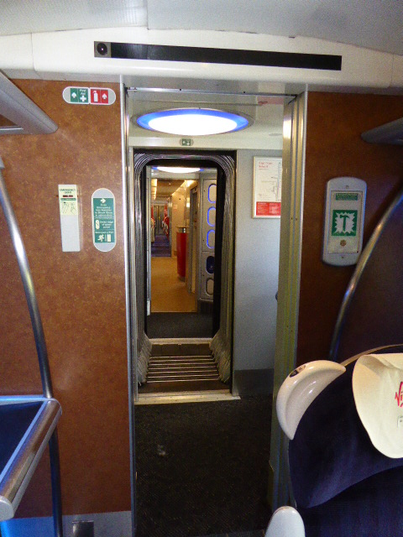
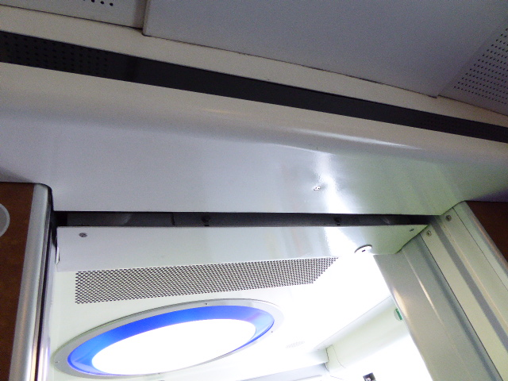
Dimensions : First Class Entrance
65.5cm
90cm
17cm
4.5cm
32cm
204cm
12.5cm
Top of Entrance into First Class Carriage
Entrance into First Class Carriage

